Slide 1

Why Visualization?

Slide 2

human perception
is powerful
flickr cc 2.0
Star Gazing by uditha wickramanayaka
]
Notes:
As human we are quite good at making sense of the information around us visually. In fact, highest bandwidth cognitive channel is vision and have 70% sense perceptors are visual.
Photo: https://flic.kr/p/pBzR53

Slide 3
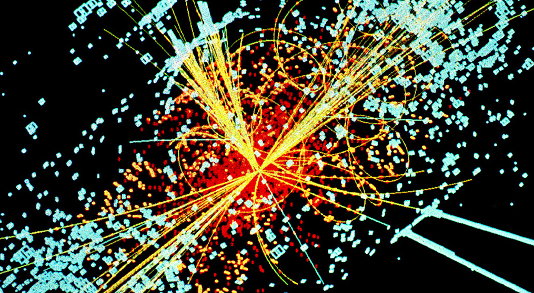
flickr cc 2.0
Big_Data_Higgs by KamiPhuc
Notes:
Data growing at an astounding rate, computational methods alone are not able to keep pace.
Photo: https://flic.kr/p/in4r4H

Slide 4
What is data
visualization?

Slide 5
“the use of computer-supported, interactive, visual representations of abstract data to amplify cognition.”
[Mackinlay, Card, & Shneiderman, 1999]
Notes:
We will also be discussing graphs that are not interactive, but the point of where the interactivity resides by the designer or the user or the user as the designer is one that we’ll come back to.

Slide 6
computer-supported,
interactive,
visual representations
of abstract data
Notes:
We will also be discussing graphs that are not interactive, but the point of where the interactivity resides by the designer or the user or the user as the designer is one that we’ll come back to.

Slide 7
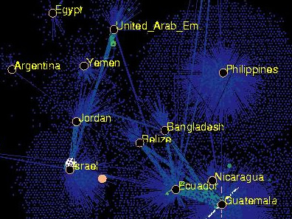
Notes:
PLACEHOLDER IMAGE from Visual Data Mining: Recognizing Telephone Calling Fraud – K. Cox, S. Eick, G. Wills the nodes represent subscribers and the edges to the countries are the total number of calls. Brightly colored nodes are unusual and warrant further investigation. Tool is NicheWorks

Slide 8
Amplifying cognition through:
increased resources
reduced search
recognition of patterns
perceptual inference
perceptual monitoring
manipulation of the medium (interaction)
[Mackinlay, Card, & Shneiderman, 1999]
Notes:
Increase resources able to offload some of the work from cognitive to the perceptual using encodings space, shape, color etc.

Slide 9
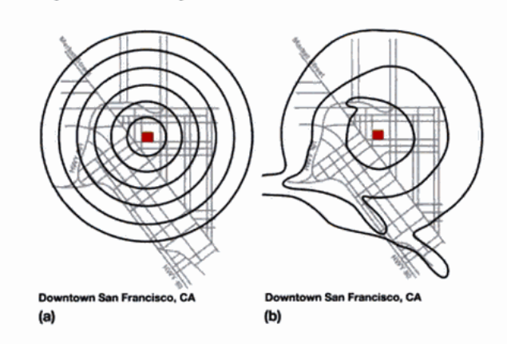
[Mackinlay, Card, & Shneiderman, 1999]
Notes:
PLACEHOLDER IMAGE Iso contours of map

Slide 10
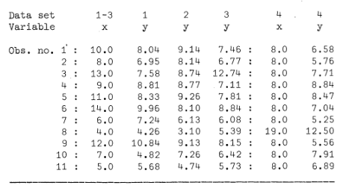
[Anscombe, 1973]

Slide 11
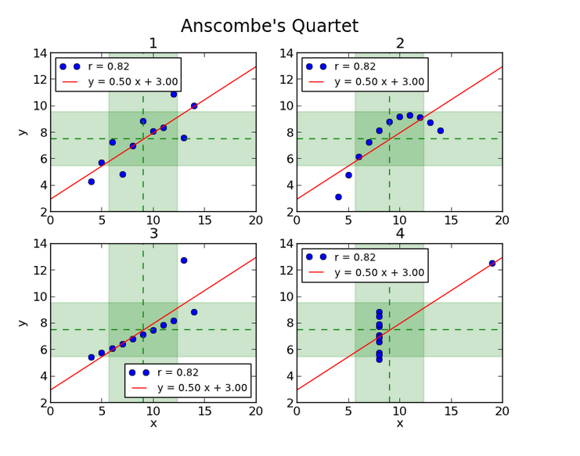
source: http://informatique-python.readthedocs.io

Slide 12
In Data Science
Derive value from data to provide actionable insights
Notes:
Visualization helps amplify cognition at various points in the process whether it’s to make decisions about the most appropriate algorithms to run, or show trends and patterns to stakeholders within your company or outside clients.

Slide 13
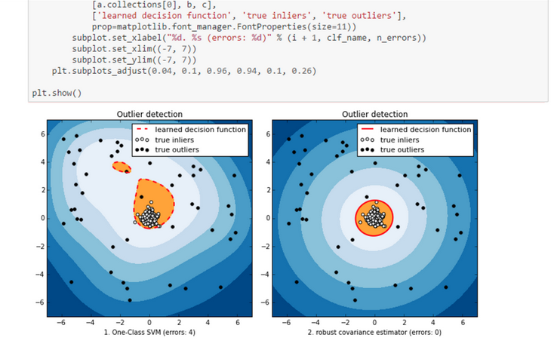
for you
https://blogs.technet.microsoft.com
Notes:
Example image for data science use.

Slide 14

for others
flickr cc 2.0
by Sebastian Sikora
Notes:
Example image for data science use.
Photo: https://flic.kr/p/dvgxhd

Slide 15


